Slide 1



Department of Computer Science and Engineering
23CS1512 - SOCIALLY RELEVANT MINIPROJECT
LegalBot: A WhatsApp-Based Legal Assistance System for Indian Law using LLM and RAG
COORDINATOR: Mr.C.ELANGOVAN
GUIDE: Mrs.M.S.VINMATHI
TEAM MEMBERS:
NITHYA SHREE C [211423104427] POOJA RAVI [211423104455]
BATCH – D23

Slide 2
ABSTRACT
Access to legal assistance in India is often limited due to cost, language barriers,and lack of awareness.
LegalBot aims to bridge this gap by providing a WhatsApp-based AI chatbot capable of offering legal guidance and information in a conversational format.
The system integrates Large Language Models (LLMs) with Retrieval-Augmented Generation (RAG) and a vector database (Pinecone) to deliver contextually accurate answers from stored legal documents.
By leveraging OpenAI GPT-4, LangChain, and Meta’s WhatsApp Cloud API, LegalBot delivers real-time, reliable, and accessible legal assistance to users through WhatsApp.

Slide 3



SUSTAINABLE DEVELOPMENT GOAL (SDG)
TARGET FOR THIS PROJECT
SDG 16 – Peace, Justice and Strong Institutions: Promotes access to justice and legal awareness among citizens through AI-driven assistance.
SDG 9 – Industry, Innovation and Infrastructure: Demonstrates how digital innovation can modernize legal services.
SDG 10 – Reduced Inequalities: Bridges the gap between citizens and the legal system by providing equal access to legal information through a free, accessible platform.

Slide 4
PROBLEM STATEMENT
Social Problem Being Addressed:
Many individuals in India lack access to timely and affordable legal guidance. Complex laws, lack of awareness, and limited legal aid infrastructure make it difficult for citizens to understand their rights.
Who Is Affected & How:
Common citizens face confusion over legal processes.
Lawyers and institutions face overload of basic queries.
Rural and low-income users lack legal awareness.
One-Line Problem Statement:
There is no easily accessible, AI-driven system to provide legal information and guidance via commonly used platforms like WhatsApp.

Slide 5
LITERATURE REVIEW
S.No | PUBLICATIONS | INSIGHTS | METHODS USED | RESULTS
1 | LAW-U: Legal Guidance Through AI Chatbot for Sexual Violence Victims (IEEE Access, 2021) | Specialized chatbot for sexual violence survivors providing legal guidance through Supreme Court case matching. Focuses on Thai law Sections 276-279. | • 182 Supreme Court cases • NLP pipelines with spaCy • TF-IDF + keyword synonyms • Legal expert validation • 5-fold cross-validation | • 88.89% accuracy for exact matches • TOP-3 accuracy: 88.24% • Gender-neutral language design • Integrated with LINE messaging
2 | Artificial Intelligence for Legal Chatbot (Journal of Engineering Sciences, 2024) | General legal aid chatbot for traffic violations, criminal allegations using NLP and TF-IDF for legal document processing. | • Natural Language Processing (NLP) • TF-IDF algorithms • Machine Learning classification • Gradio web interface • Legal document analysis | • TF-IDF optimal for legal text accuracy • Real-time document analysis capability • User-friendly interface • Multi-category legal assistance
3 | Automated Legal Text Classification Using Random Forests and Deep Learning (Information Processing & Management, 2021) | Comparative study on legal text classification using domain concepts vs. deep learning for US Supreme Court cases. | • Domain Concept Extraction (DCE) • Random Forests classifier • PCA feature selection • BERT, Word2Vec, GloVe embeddings • 30,000 US case documents | • Domain Concepts + RF: 84.49% accuracy • Top 400 domain concepts optimal • Outperformed deep learning models • Better interpretability than deep learning
4 | Law Chatbot (IJRASET, 2024) | General-purpose legal chatbot using RAG architecture for comprehensive legal information retrieval and generation. | • Text retrieval and generation • FAISS vector database • SentenceTransformer embeddings • LlamaCpp language model • Tokenization and chunking | • Successful IPC section retrieval • Multi-platform accessibility • Free/low-cost legal assistance • Comprehensive legal knowledge base

Slide 6
BASE PAPER
Title: LegalBot-EC: An LLM-Based Chatbot for Legal Assistance in Ecuadorian Law
Authors: Francklin Rivas-Echeverría, Leo Thomas Ramos, José Luis Ibarra, Sonia Zerpa-Bonillo, Stalin Arciniegas, and Marilena Asprino-Salas
Key Learnings:
LLMs can understand and explain complex legal information.
WhatsApp integration makes legal help easy to access.
RAG improves accuracy by using stored legal data.
Chat history helps maintain conversation flow.
AWS Lambda deployment provides easy scaling and low cost.
Gaps Identified
No connection to live or updated legal databases.
Limited to basic legal topics; needs wider coverage.
Supports only English; needs regional language support.
Data privacy and security need more focus.
Does not clearly show which law or document was used for each answer.

Slide 7
EXISTING SYSTEM
Current System:
Citizens depend on manual legal consultation.
Legal resources are scattered across multiple portals and require technical understanding.
No centralized AI system available on WhatsApp for legal help.
Limitations:
Time-consuming and costly consultations.
Inconsistent or outdated information.
No automated knowledge retrieval or contextual awareness.

Slide 8
PROPOSED SOLUTION & SYSTEM
Proposed Solution:
A WhatsApp-integrated LegalBot that provides instant legal assistance using LLM + RAG architecture. The chatbot retrieves relevant data from Pinecone (vector database) and generates accurate responses using GPT-4 via LangChain.
Advantages:
Instant, AI-powered legal replies.
Context-aware answers using stored history.
Simple and accessible through WhatsApp.
Deployed on AWS Lambda for scalability and cost efficiency.

Slide 9
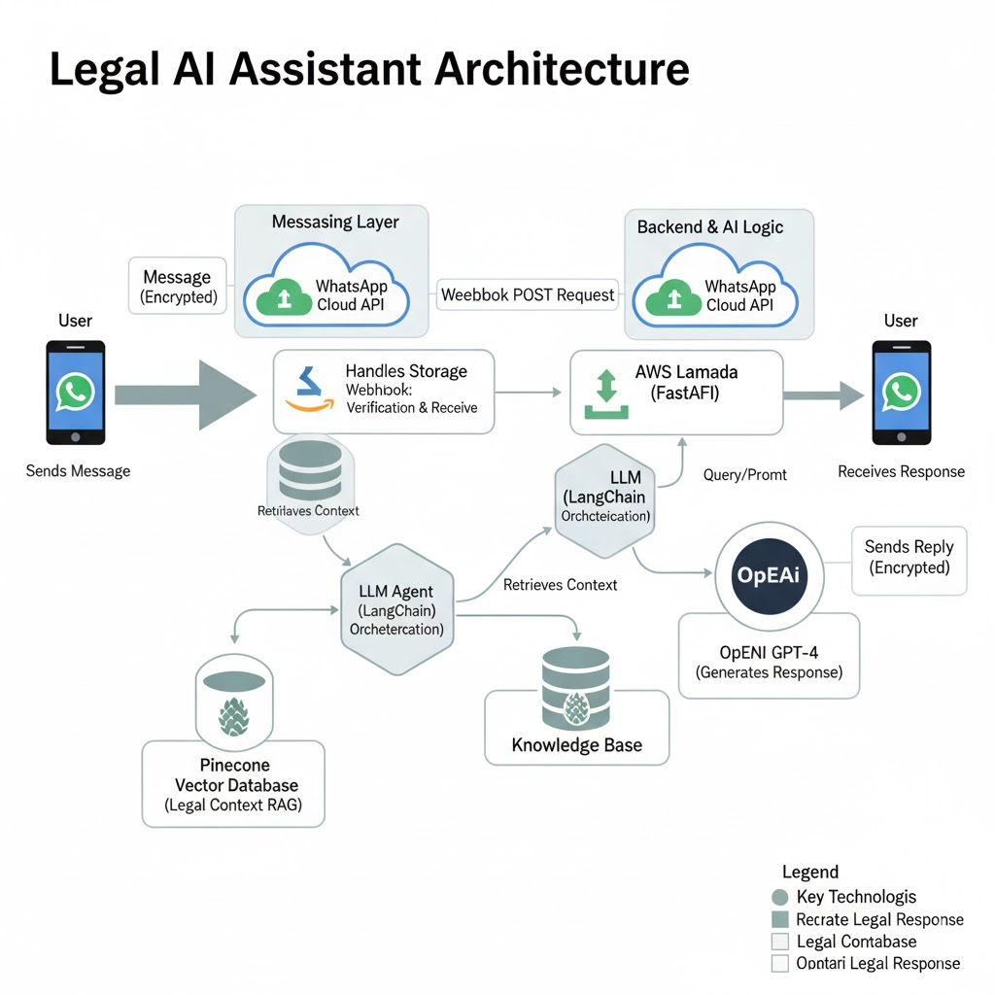
ARCHITECTURE
Flow Overview:
User sends message via WhatsApp.
Meta’s Cloud API forwards it to AWS Lambda.
FastAPI handles webhook (verify + message receive).
Message is stored and processed by LLM agent.
RAG retrieves legal context from Pinecone.
GPT-4 generates accurate legal response.
Reply is sent back to the same user via WhatsApp.
Technologies:
WhatsApp Cloud API, FastAPI , AWS Lambda,LangChain ,OpenAI GPT-4 , Pinecone

Slide 10
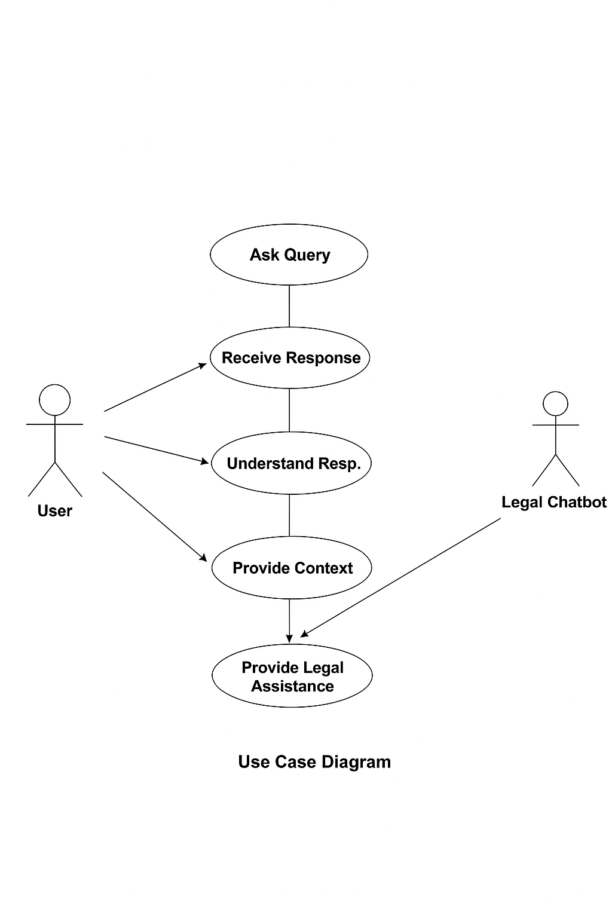
USECASE DIAGRAM
1. Send Message
The user sends a legal question or query through WhatsApp. The message is received by the LegalBot system via the WhatsApp Cloud API and forwarded to the backend (AWS Lambda) for processing.
2. Retrieve Legal Information
LegalBot searches the Pinecone database to find relevant legal data, documents, or previous chat history that matches the user’s query using similarity-based retrieval.
3. Generate AI-Based Legal Response
The system uses GPT-4 through LangChain to analyze the user’s message and the retrieved legal context. It then generates a clear, accurate, and conversational legal response.
4. Store Chat History
Every user query and the corresponding AI response are stored in the Pinecone vector database. This allows the chatbot to remember previous interactions and maintain context for future conversations.

Slide 11
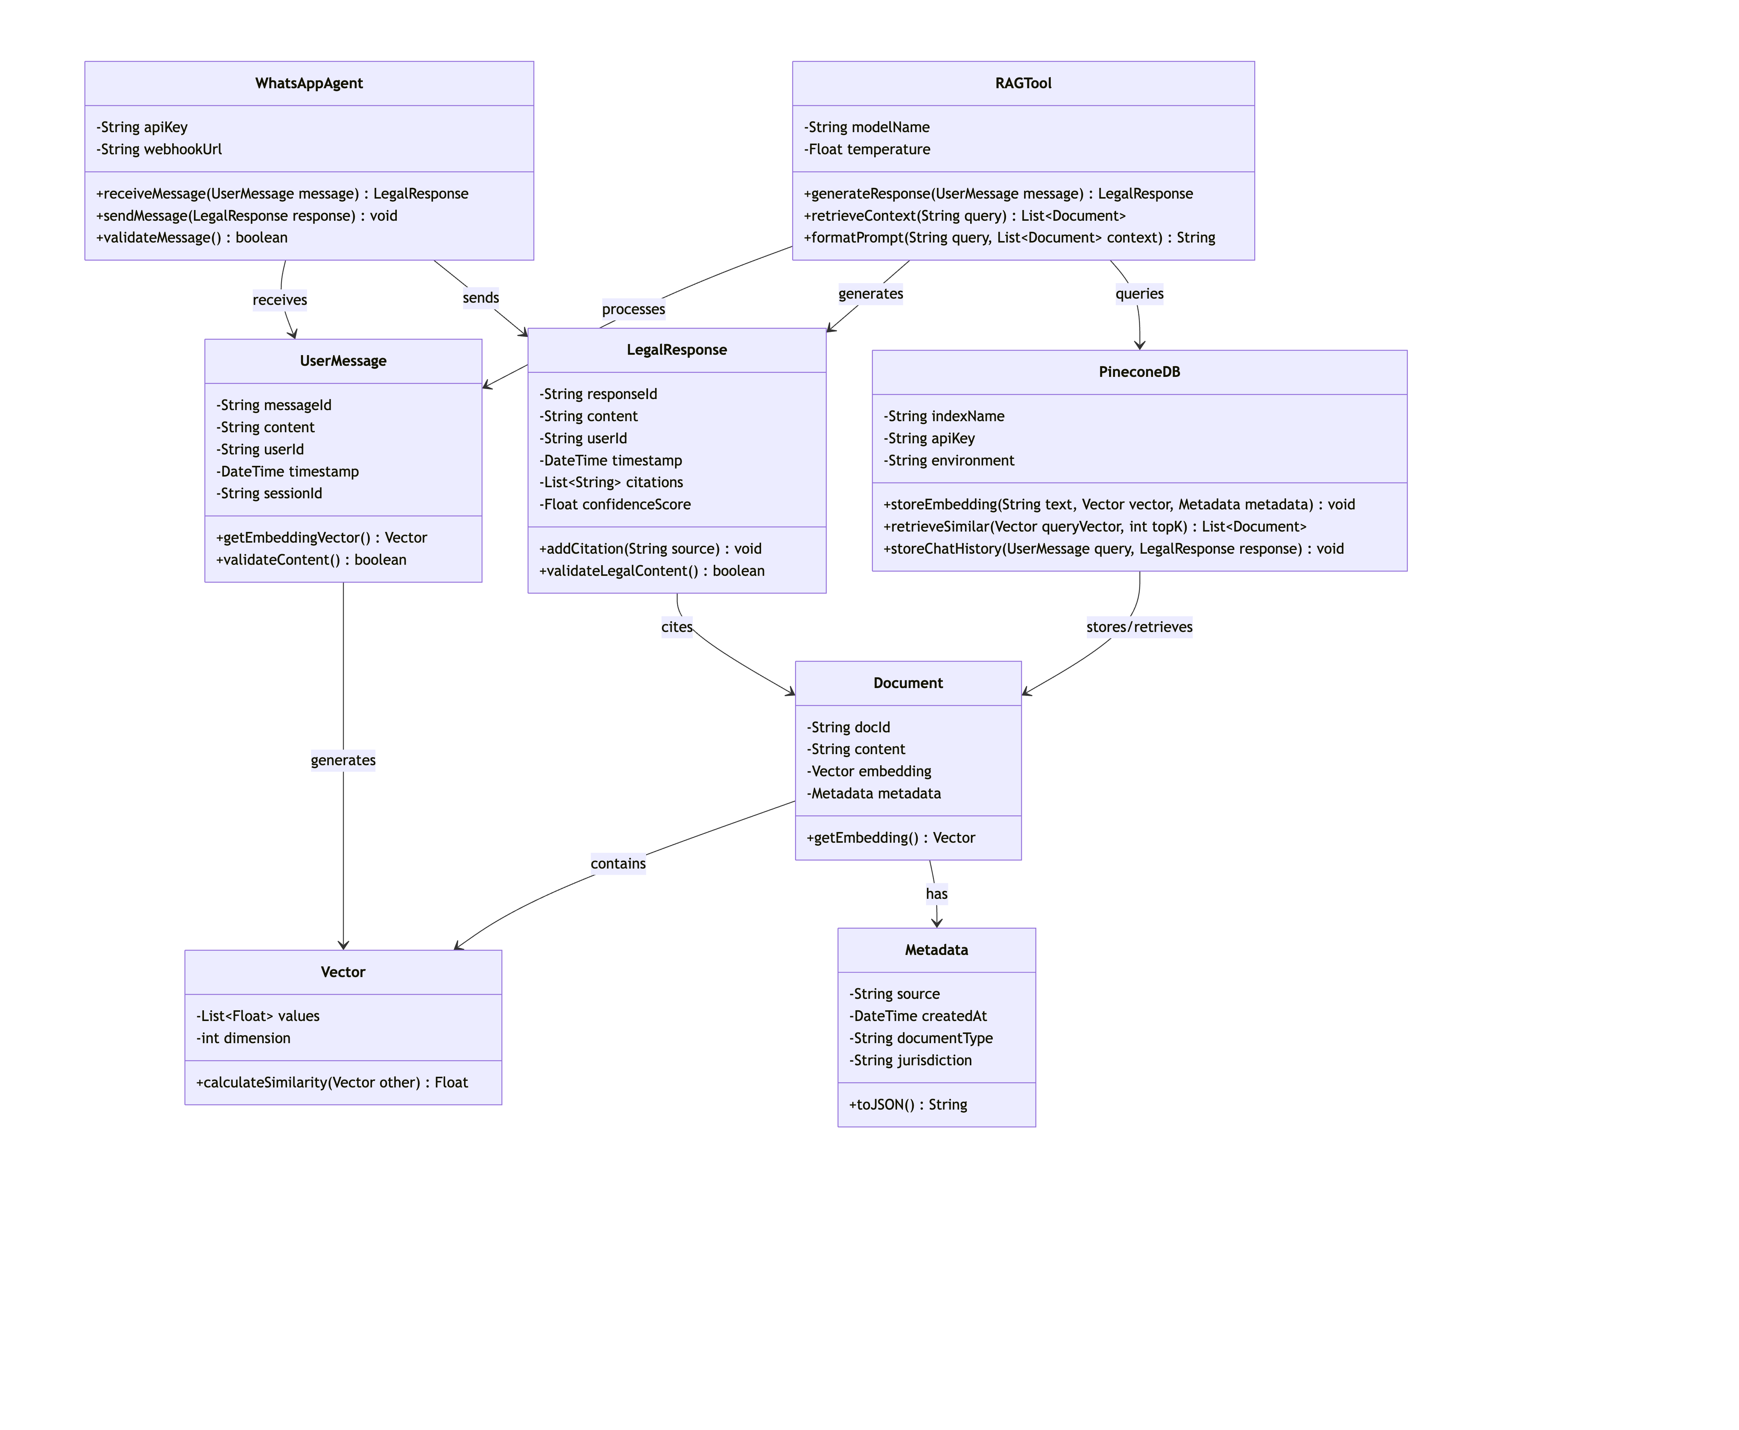
CLASS DIAGRAM

Slide 12
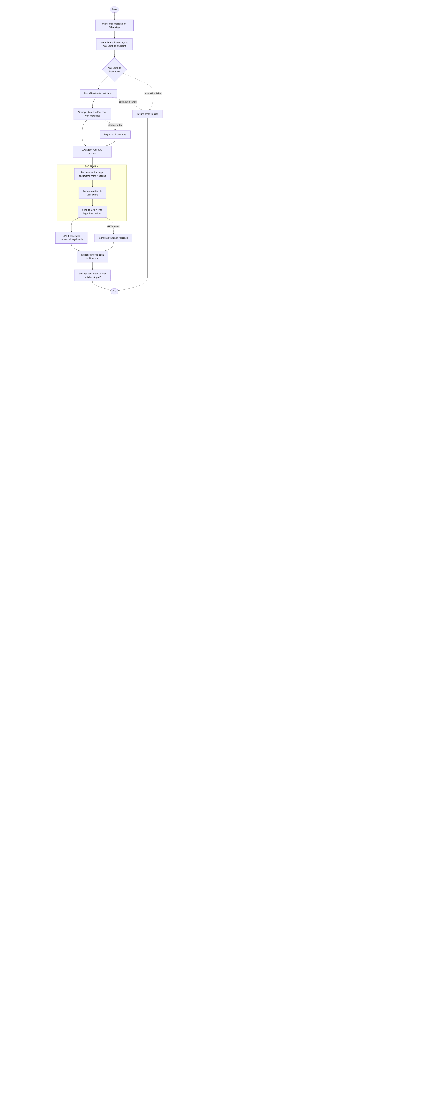
ACTIVITY DIAGRAM
1. Get the Message
You send a message on WhatsApp.
WhatsApp (owned by Meta) forwards it to the Bot's "brain" (the AWS Lambda function).
2. Understand and Remember the Question
The brain uses a tool (FastAPI) to read the text of your message.
It immediately writes your question down in its notebook (Pinecone database) so it doesn't forget.
3. Find the Answer This is the main work, called the "RAG Process":
Search: The bot looks through its notebook of legal information to find facts related to your question.
Prepare: It gathers those facts and your question into a neat package.
Ask the Expert: It sends that package to a super-smart legal expert (GPT-4) to draft a good answer.
4. Deliver the Answer
The expert (GPT-4) sends back a well-written legal reply.
The bot writes this answer down in its notebook next to your original question.
Finally, it sends the answer back to you on WhatsApp.

Slide 13
HARDWARE & SOFTWARE REQUIREMENTS
Hardware:
Processor: Intel i5/i7 or AMD Ryzen 5/7
RAM: 8 GB (16 GB recommended)
Storage: 256 GB SSD minimum
Software:
Language: Python 3.10+
Framework: FastAPI
Libraries: LangChain, Pinecone, OpenAI, HTTPX, Mangum
Cloud: AWS Lambda + API Gateway
Platform: WhatsApp Cloud API (Meta Developer)

Slide 14
IMPLEMENTATION
Key Implementation Steps:
Webhook Setup: FastAPI handles GET verification and POST message events.
Message Processing: Extracts sender ID and text; persists to Pinecone.
Agent Creation: LangChain agent built using GPT-4 + RAGTool for retrieval.
Response Generation: Retrieves context and generates AI legal response.
Response Delivery: Sends message back via WhatsApp Cloud API.
Deployment: Deployed on AWS Lambda using Mangum for serverless execution.

Slide 15
TESTING
Testing Types:
Unit Testing:
Verified individual modules like message parsing and API calls.
Integration Testing:
Checked message flow from WhatsApp → Lambda → OpenAI → reply.
Functional Testing:
Ensured correct retrieval and accurate response.
System Testing:
Validated AWS deployment, latency, and scalability.
User Acceptance Testing:
Verified real-time response via WhatsApp demo.

Slide 16
MODULE -1
Module 1: WhatsApp Integration
Description:
This module connects the LegalBot system to WhatsApp via the Meta Cloud API. It manages message exchange between users and the backend, handling both webhook verification and real-time messaging.
Key Features:
Webhook verification and message parsing.
Receives user queries through WhatsApp.
Sends responses back using HTTPX client via the WhatsApp Cloud API.
Ensures secure communication with access tokens.
Handles different message types (text, media, interactive).

Slide 17
MODULE - 2
Module 2: LLM Agent
Description:
The core intelligence of LegalBot, powered by GPT-4 and LangChain. This module interprets user queries, understands context, and generates legally accurate responses in natural language.
Key Features:
Uses GPT-4 for advanced legal language understanding.
Built with LangChain for modular and tool-based reasoning.
Integrates a system prompt tailored for Indian law context.
Handles dynamic and multi-turn conversations.
Ensures clear, concise, and context-aware responses.

Slide 18
MODULE - 3
Module 3: RAG and Pinecone Storage
Description:
This module enhances response accuracy through Retrieval-Augmented Generation (RAG). It stores and retrieves conversation history and legal documents using Pinecone’s vector database for semantic search.
Key Features:
Stores chat history and document embeddings in Pinecone.
Retrieves top-K relevant contexts for better responses.
Maintains long-term memory of user interactions.
Supports similarity-based retrieval for contextual understanding.
Enables continuous learning and adaptive responses.

Slide 19
MODULE - 4
Module 4: AWS Deployment
Description:
This module deploys the entire LegalBot system as a serverless application using AWS Lambda. It ensures scalability, security, and reliable performance for real-time WhatsApp interactions.
Key Features:
FastAPI hosted on AWS Lambda using Mangum.
HTTPS endpoints exposed via AWS API Gateway.
Environment variables securely managed via AWS KMS.
Auto-scaling and pay-per-use model for cost efficiency.
Integrated CloudWatch logging and monitoring.

Slide 20
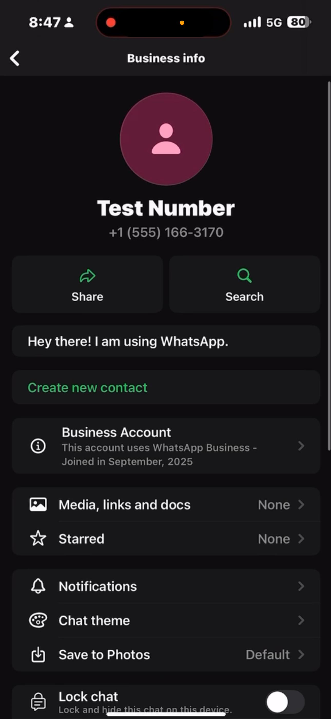
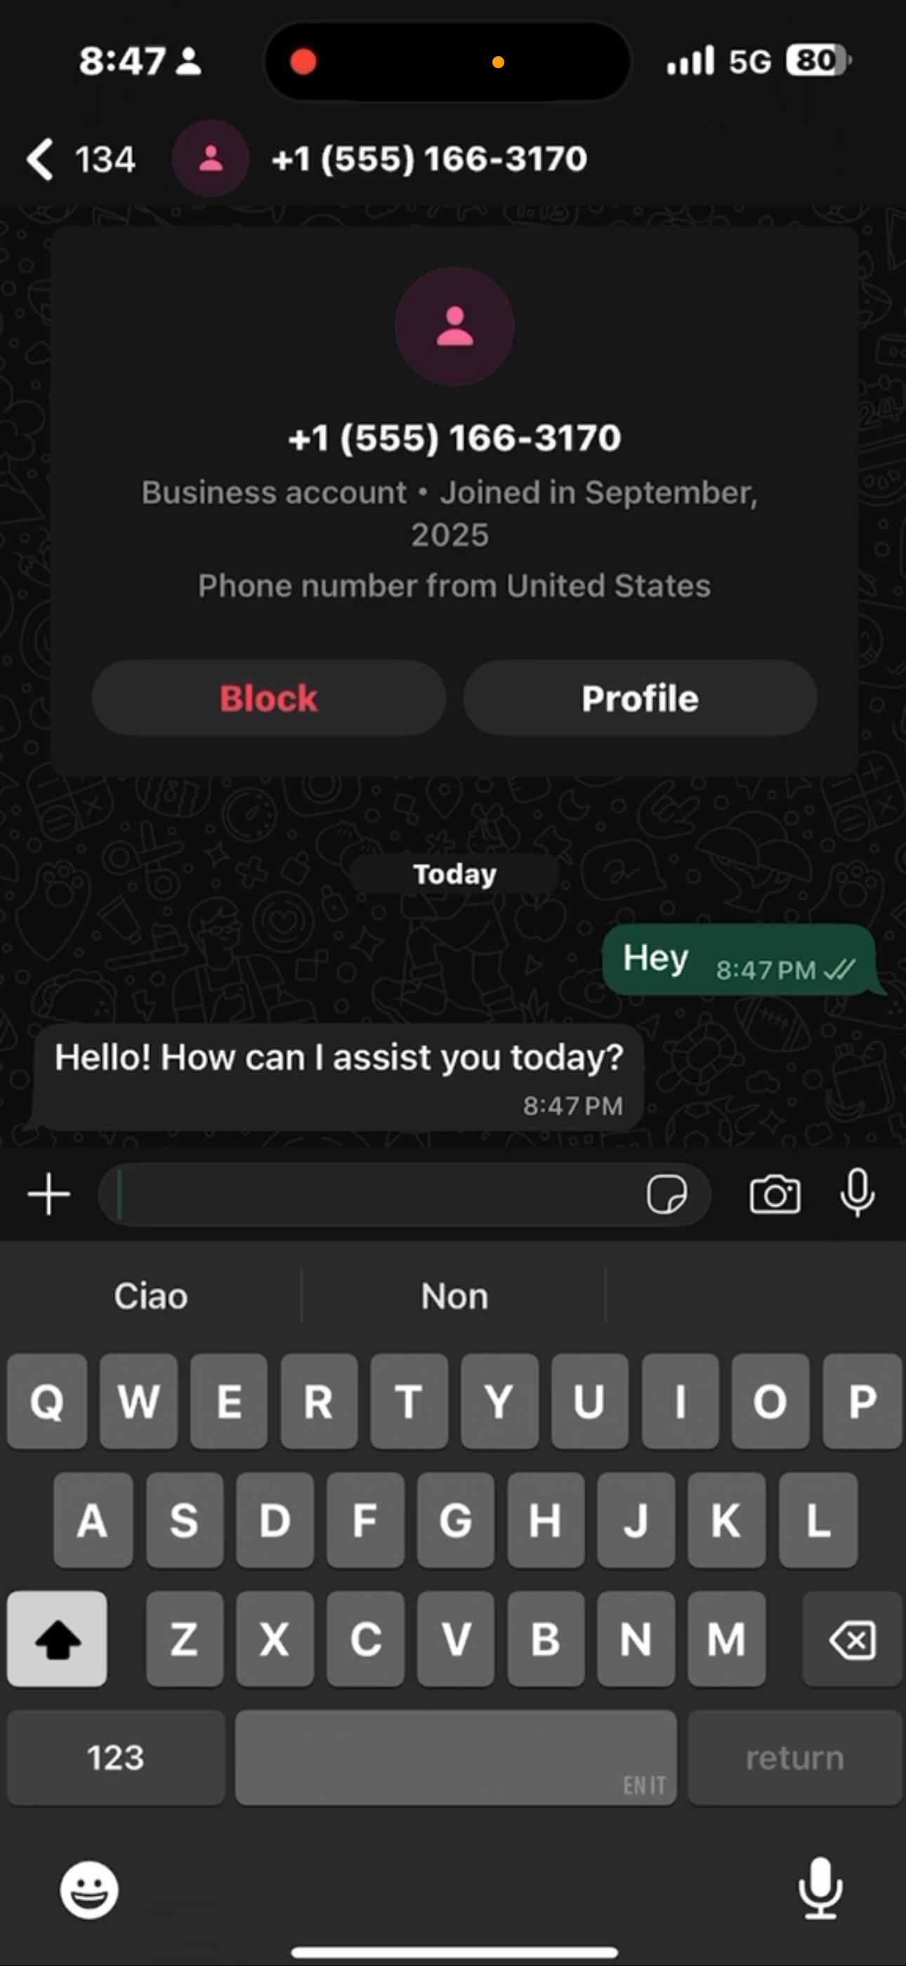
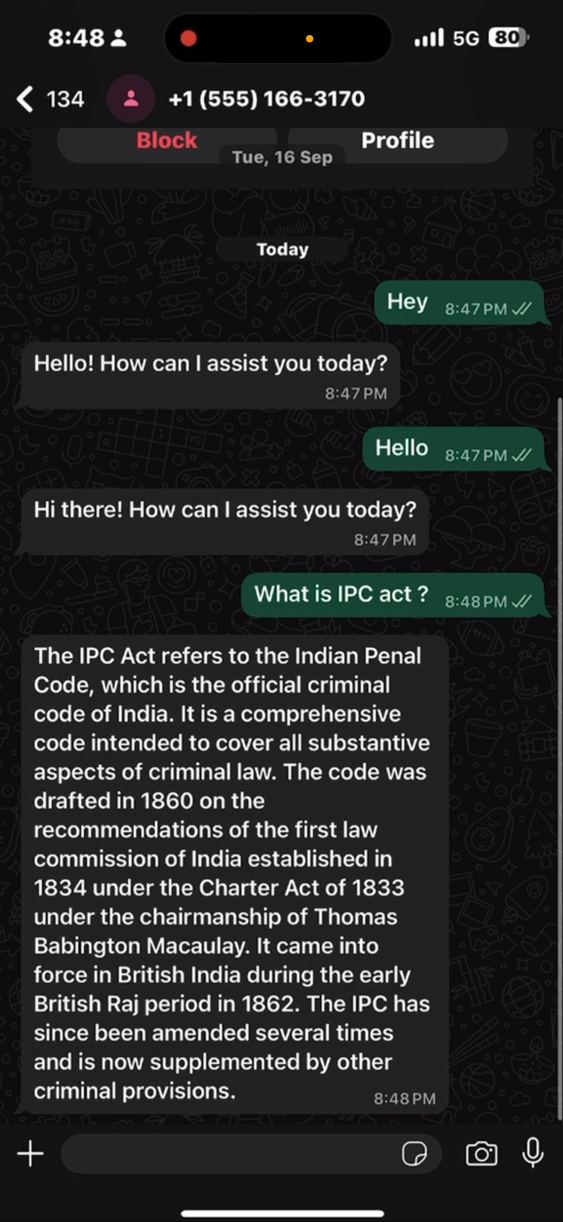
SCREENSHOTS

Slide 21
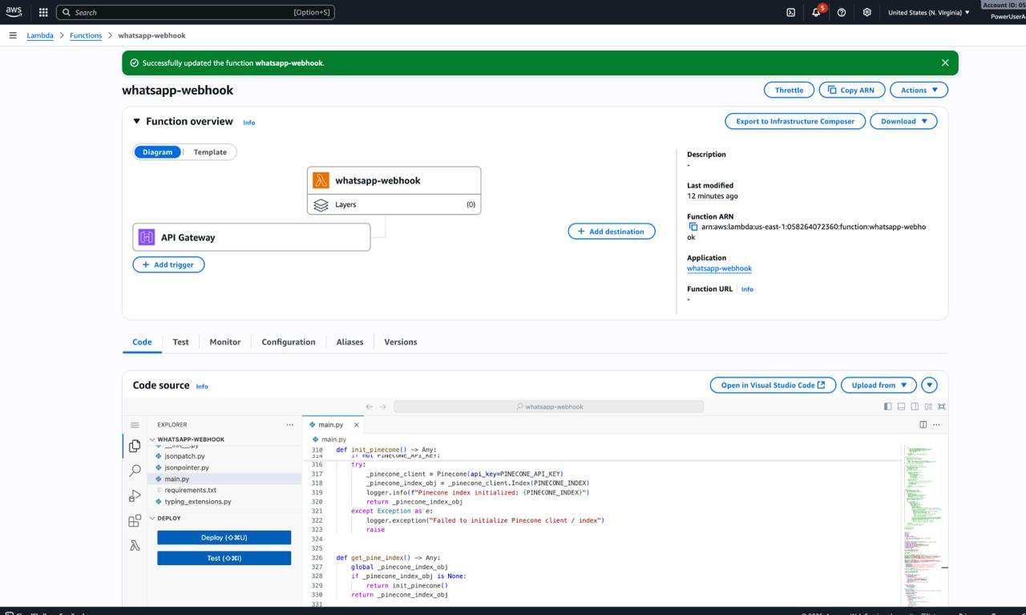
SCREENSHOTS

Slide 22
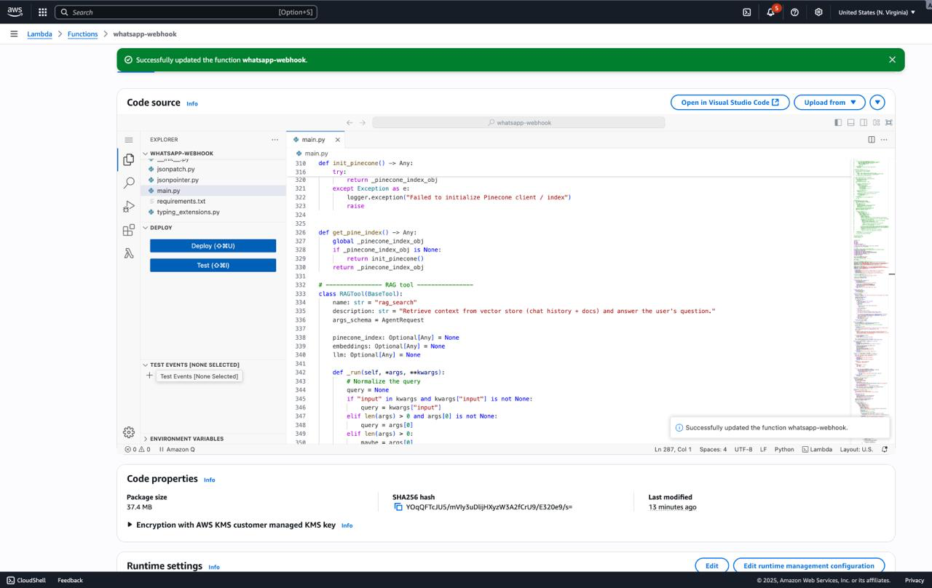
SCREENSHOTS

Slide 23
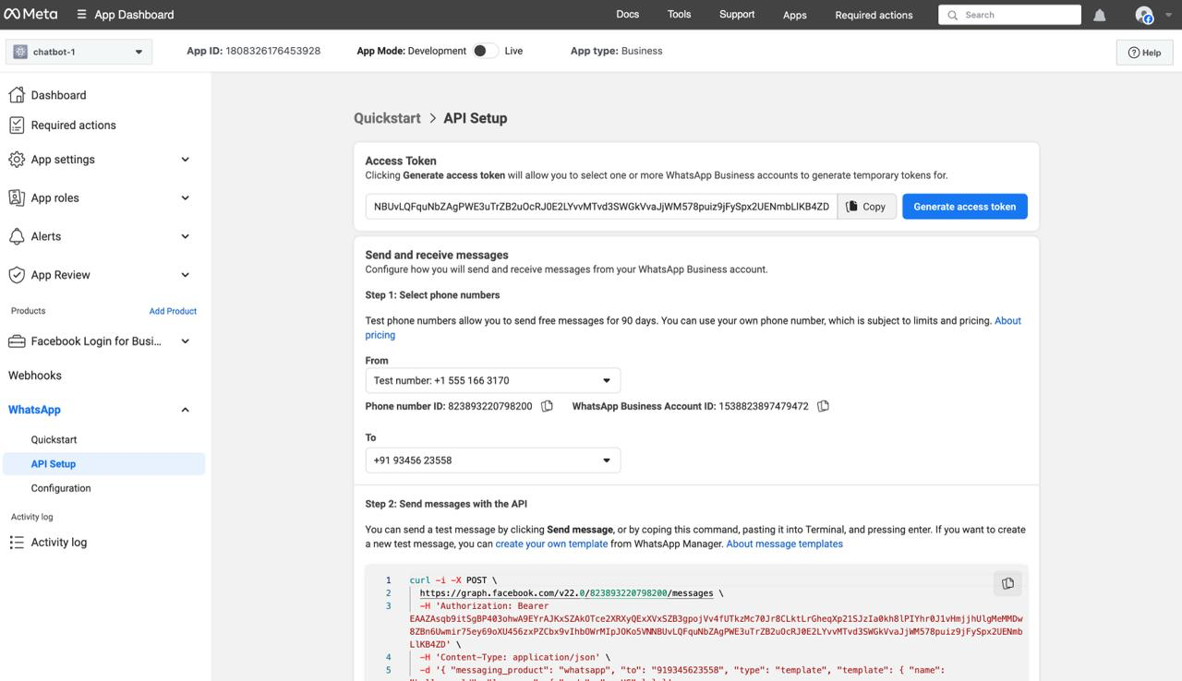
SCREENSHOTS

Slide 24
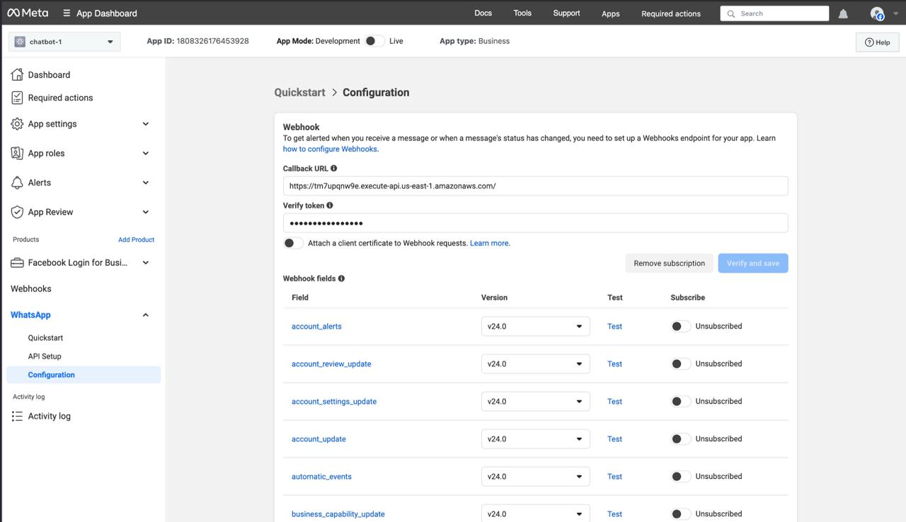
SCREENSHOTS

Slide 25
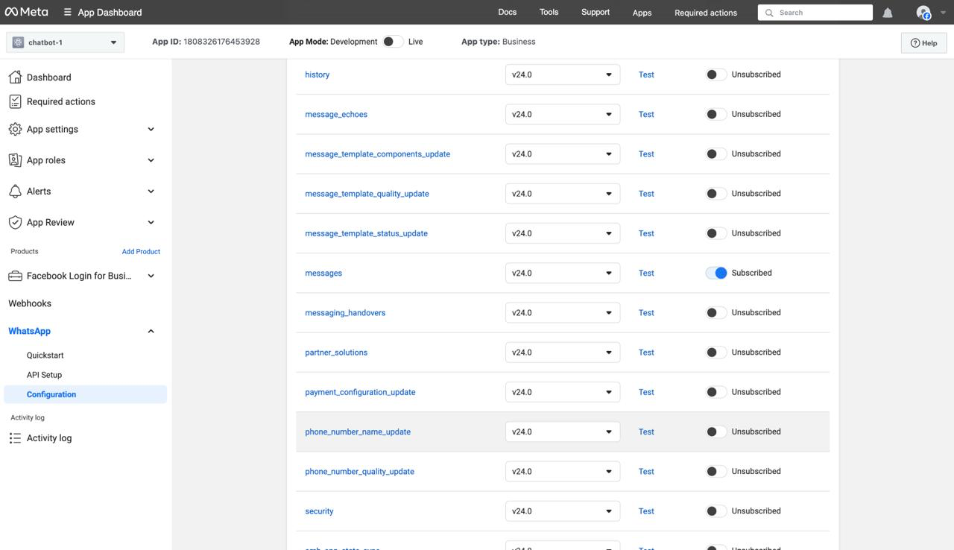
SCREENSHOTS

Slide 26
CONCLUSION & FUTURE ENHANCEMENTS
Conclusion:
LegalBot successfully provides AI-powered legal assistance via WhatsApp, making Indian law more accessible and understandable to the public. By integrating GPT-4 and Pinecone with LangChain, the system ensures reliable, context-aware, and scalable legal communication.
Future Enhancements:
Support multilingual responses (Tamil, Hindi, etc.)
Integrate voice-to-text and document uploads.
Expand to other messaging platforms.
Include case-law summarization and real-time legal updates.

Slide 27
REFERENCES
[1] F. Rivas-Echeverría, L. T. Ramos, J. L. Ibarra, S. Zerpa-Bonillo, S. Arciniegas, and M. Asprino-Salas,“LegalBot-EC: An LLM-Based Chatbot for Legal Assistance in Ecuadorian Law,”.
[2] M. R. Singh, S. Ahmad, K. Sharma, P. Sharma, and P. Kaushik, “AI-Driven Legal Assistance: Optimizing Document Retrieval and Case Classification with NLP Techniques,” in Proc. 2025 Int. Conf. Advances in Modern Age Technologies for Health and Engineering Science (AMATHE), 2025, pp. 1–10. doi: 10.1109/AMATHE65477.2025.11080869.
[3] A. Dutta, K. K. Sarma, and Y. S. P., “AI Legal Assistant for IPC,” in Proc. 2024 8th Int. Conf. Computational System and Information Technology for Sustainable Solutions (CSITSS)
[4] N. K. Sahu, N. Mishra, R. Soni, P. N. P. Naidu, and P. Pawar, “Development of Assistance System for Online Dispute Resolution and Legal Advice using AIML,” in Proc. 2025 Int. Conf. Computational, Communication and Information Technology (ICCCIT), 2025, pp. 142–145. doi: 10.1109/ICCCIT62592.2025.10927904.
[5] K. R., V. G. R., D. N., S. N. C., and S. V. Y., “Ethical and Legal Implications of AI Chatbots in Legal Sector,” in Proc. 2025 Int. Conf. Computational Robotics, Testing and Engineering Evaluation (ICCRTEE), 2025, pp. 1–5. doi: 10.1109/ICCRTEE64519.2025.11053085.
[6] S. Marrivagu and A. R. S., “Artificial Intelligence for Legal Chatbot,” J. Eng. Sci., vol. 15

Slide 28
[7] A. R. Kandula et al., “Design and Implementation of a Chatbot for Automated Legal Assistance using Natural Language Processing and Machine Learning,” in Proc. 2023 Annu. Int. Conf. Emerging Research Areas: Int. Conf. Intelligent Systems (AICERA/ICIS), 2023, pp. 1–6. doi: 10.1109/AICERA/ICIS59538.2023.10420298.
[8] D. Kurniawan and S. E. Hiererra, “AI Legal Companion: Enhancing Access to Justice and Legal Literacy for the Public,” in Proc. 2024 Int. Conf. ICT for Smart Society (ICISS), 2024, pp. 1–6. doi: 10.1109/ICISS62896.2024.10751371.
[9] D. Jain, M. D. Borah, and A. Biswas, “Summarization of Legal Documents: Where Are We Now and the Way Forward,” Comput. Sci. Rev., vol. 40, 2021, Art. no. 100388. doi: 10.1016/j.cosrev.2021.100388.
[10] Z. Misquitta et al., “Law Chatbot,” Int. J. Res. Appl. Sci. Eng. Technol., vol. 12, no. 5, pp. 164–170, 2024.
[11] H. Chen et al., “A Comparative Study of Automated Legal Text Classification Using Random Forests and Deep Learning,” Inf. Process. Manage., vol. 59, no. 1, 2022, Art. no. 102759. doi: 10.1016/j.ipm.2021.102759.
[12] N. K., R. Sharma, E. Srivastav, A. Patel, D. P. Rana, and A. Singh, “LAWBOT: A Smart User Indian Legal Chatbot using Machine Learning Framework,” in Proc. 2024 IEEE 9th Int. Conf. Convergence in Technology (I2CT), 2024, pp. 1–7. doi: 10.1109/I2CT61223.2024.10543337.

Slide 29
[13] T. Nethassanai et al., “Mari: Automating Responses to Thai Legal Debt Queries Using Generative AI and Retrieval-Augmented Generation,” in Proc. 2025 22nd Int. Conf. Electrical Engineering/Electronics, Computer, Telecommunications and Information Technology (ECTI-CON), 2025, pp. 1–7. doi: 10.1109/ECTI-CON64996.2025.11101123.
[14] C. Trivedi et al., “Leveraging AI-Driven Chatbots for Legal Literacy: Advanced Computing and Communication Technologies for Legal Awareness,” in Proc. 2024 Int. Conf. Artificial Intelligence and Quantum Computation-Based Sensor Application (ICAIQSA), 2024, pp. 1–7. doi: 10.1109/ICAIQSA64000.2024.10882305.
[15] M. Queudot, É. Charton, and M.-J. Meurs, “Improving Access to Justice with Legal Chatbots,” Stats, vol. 3, no. 3, pp. 356–375, 2020. doi: 10.3390/stats3030023.
[16] B. Pardhi, S. Koli, V. Khanzode, and A. S. Raut, “LEGALBOT – AI Law Advisor Chatbot,” Int. J. Novel Res. Develop., vol. 9, no. 4, pp. 247–256, 2024.
[17] R. A. Kalpana, S. Karunya, and R. Rashmi, “Legal Solutions – Intelligent Chatbot Using Machine Learning,” in Proc. 2023 Intell. Comput. Control Eng. Business Syst. (ICCEBS), 2023, pp. 1–6. doi: 10.1109/ICCEBS58601.2023.10448748.
[18] R. A. Kumar et al., “Revolutionizing Legal Workflows: Advanced AI Techniques for Document Summarization, Legal Translation, and Conversational Assistance,” in Proc. 2025 Int. Conf. Adv. Comput. Technol. (ICOACT), 2025, pp. 1–4. doi: 10.1109/ICOACT63339.2025.11004791.

Slide 30
THANK YOU

